Slide 1
HA & SCALING
All about High Availability and Scaling.

Slide 2
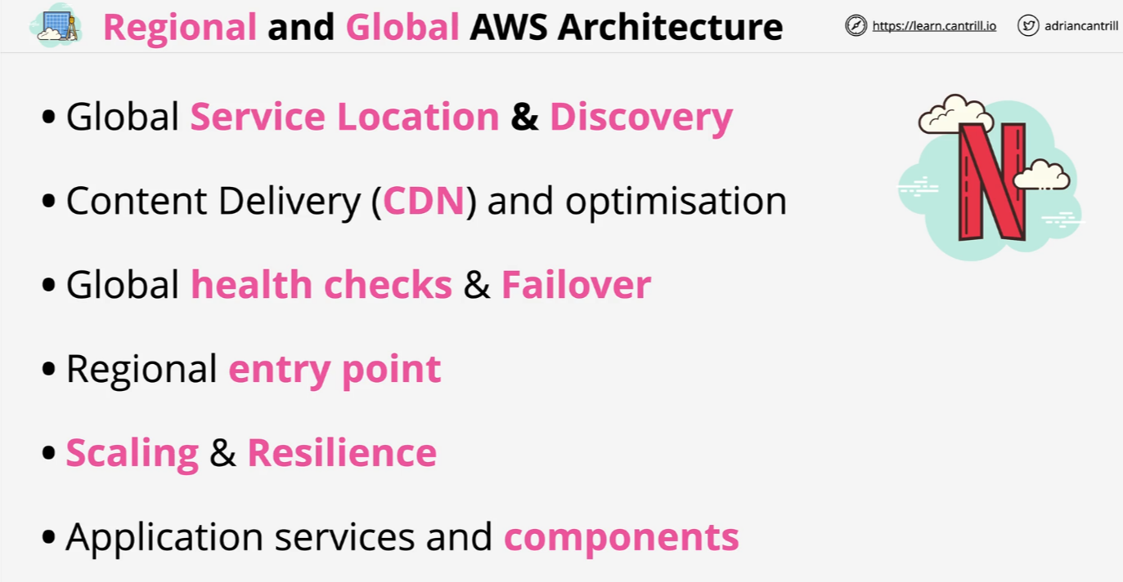
Regional and Global AWS Architecture

Slide 3
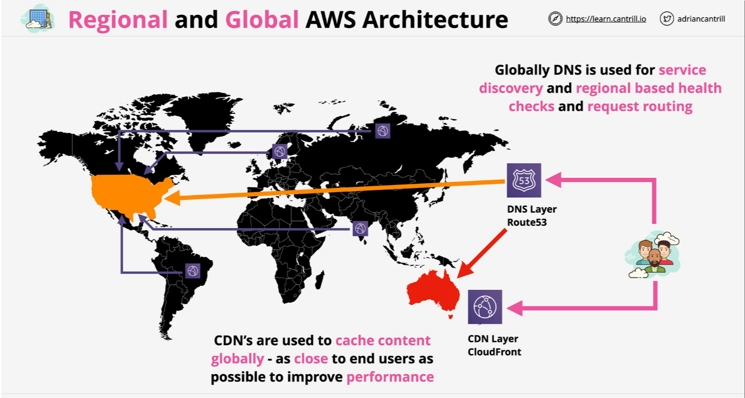
Regional and Global AWS Architecture

Slide 4
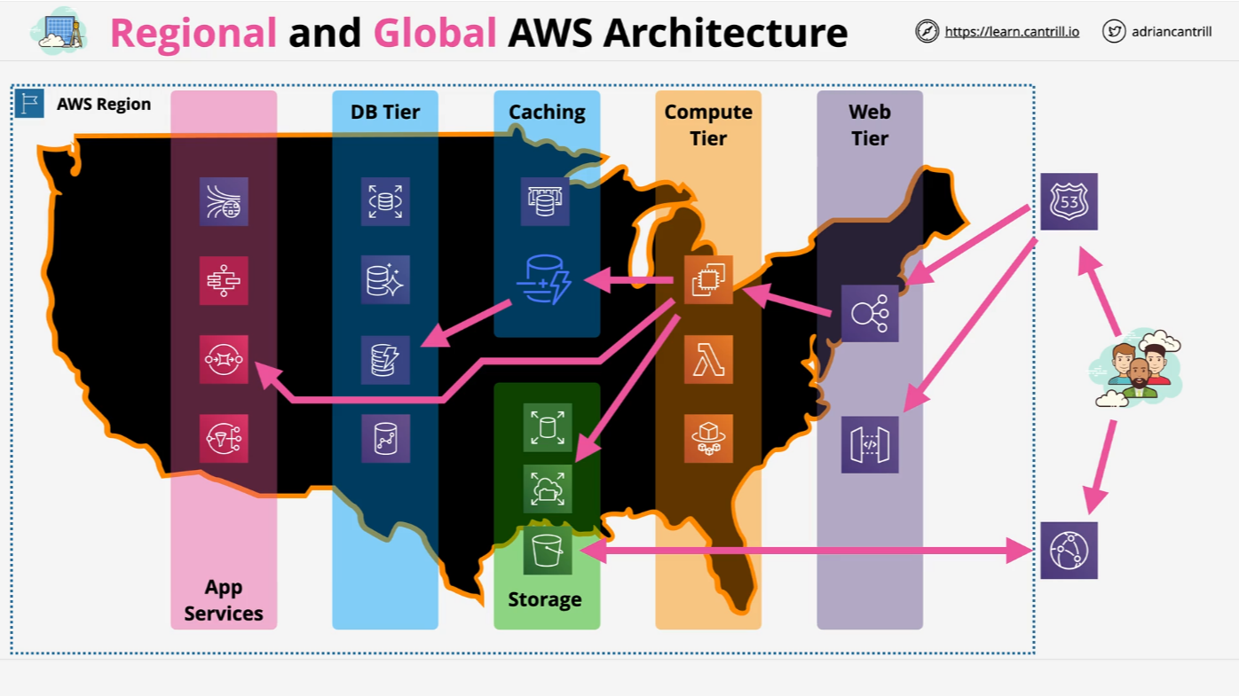
Regional and Global AWS Architecture

Slide 5
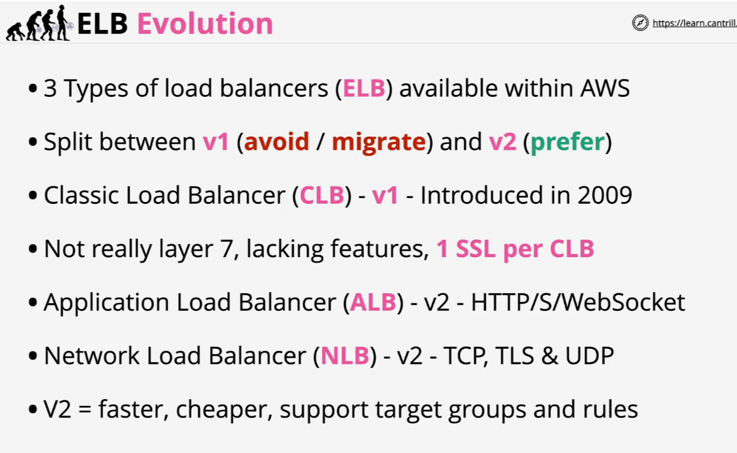
Evolution of the Elastic Load Balancer

Slide 6
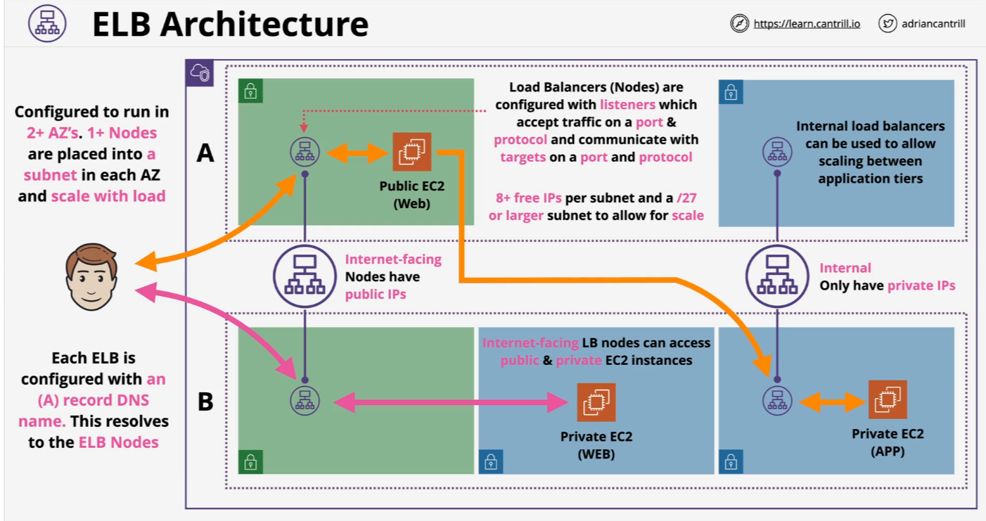
Elastic Load Balancer Architecture

Slide 7
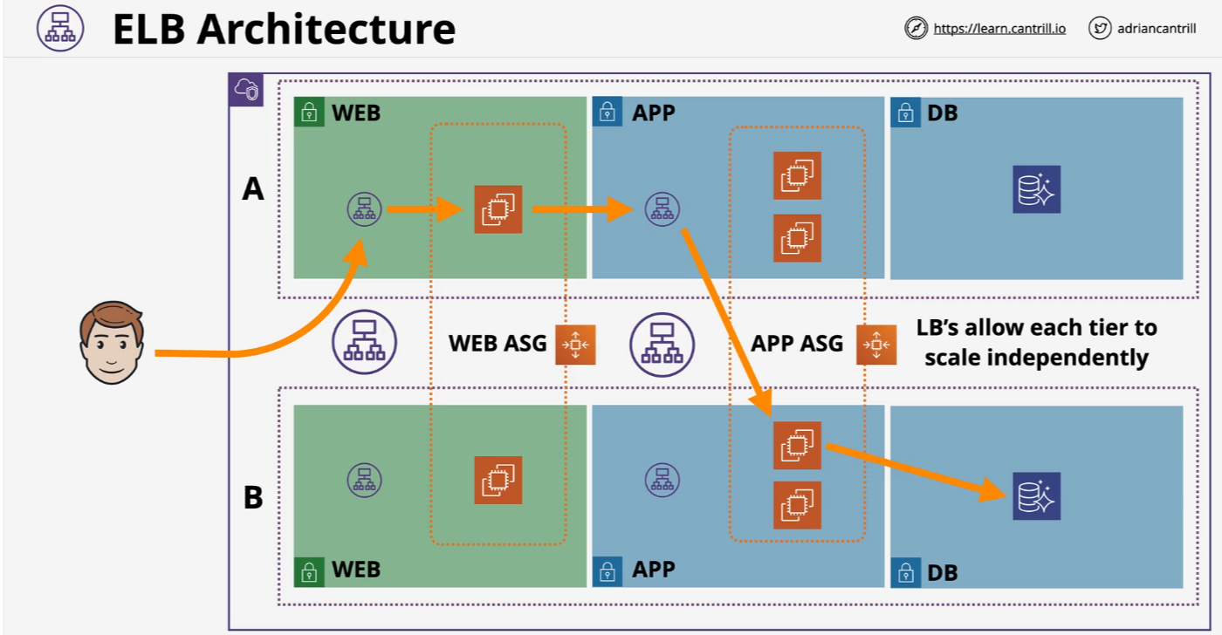
Elastic Load Balancer Architecture

Slide 8
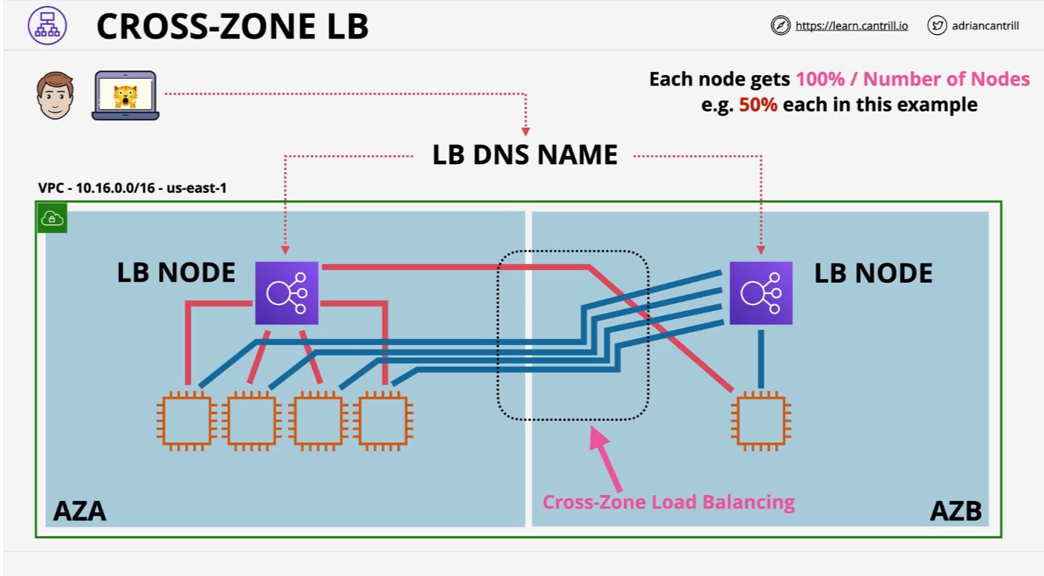
Elastic Load Balancer Architecture

Slide 9
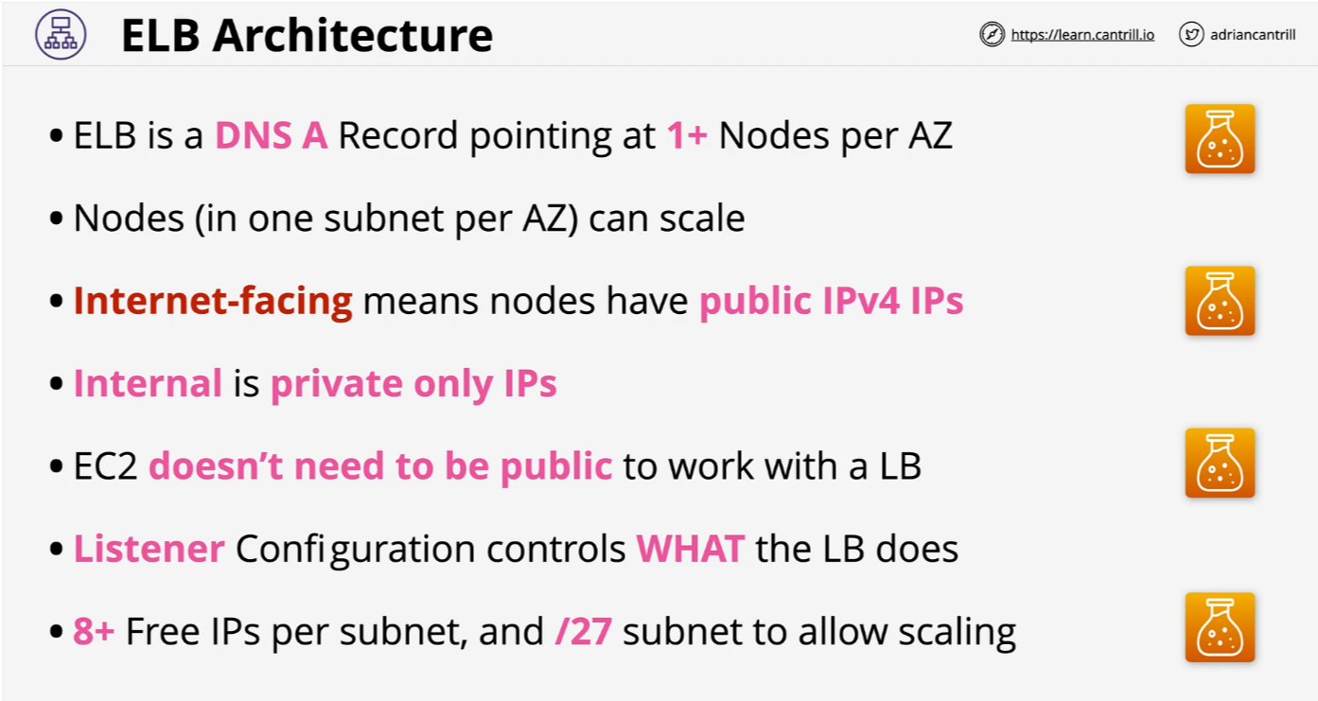
Elastic Load Balancer Architecture

Slide 10
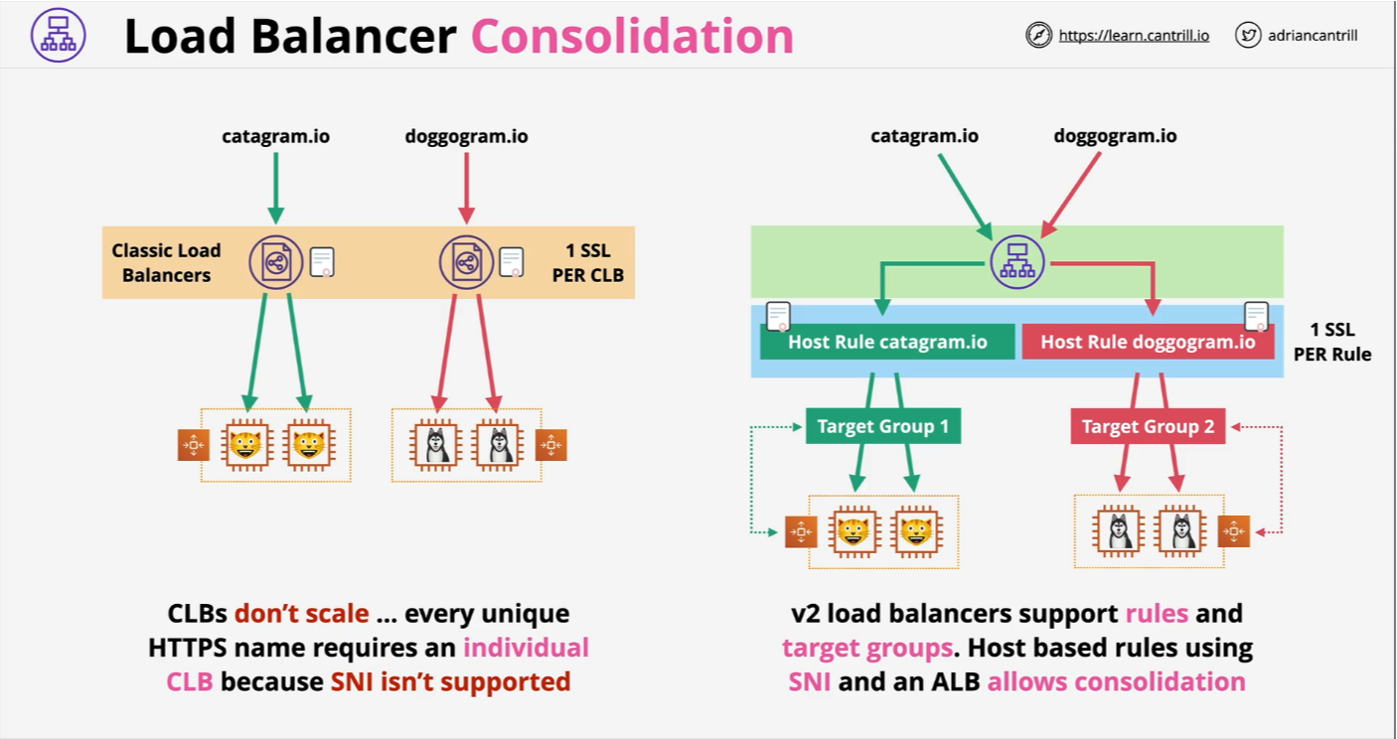
Application Load balancing (ALB) vs Network Load Balancing (NLB)

Slide 11
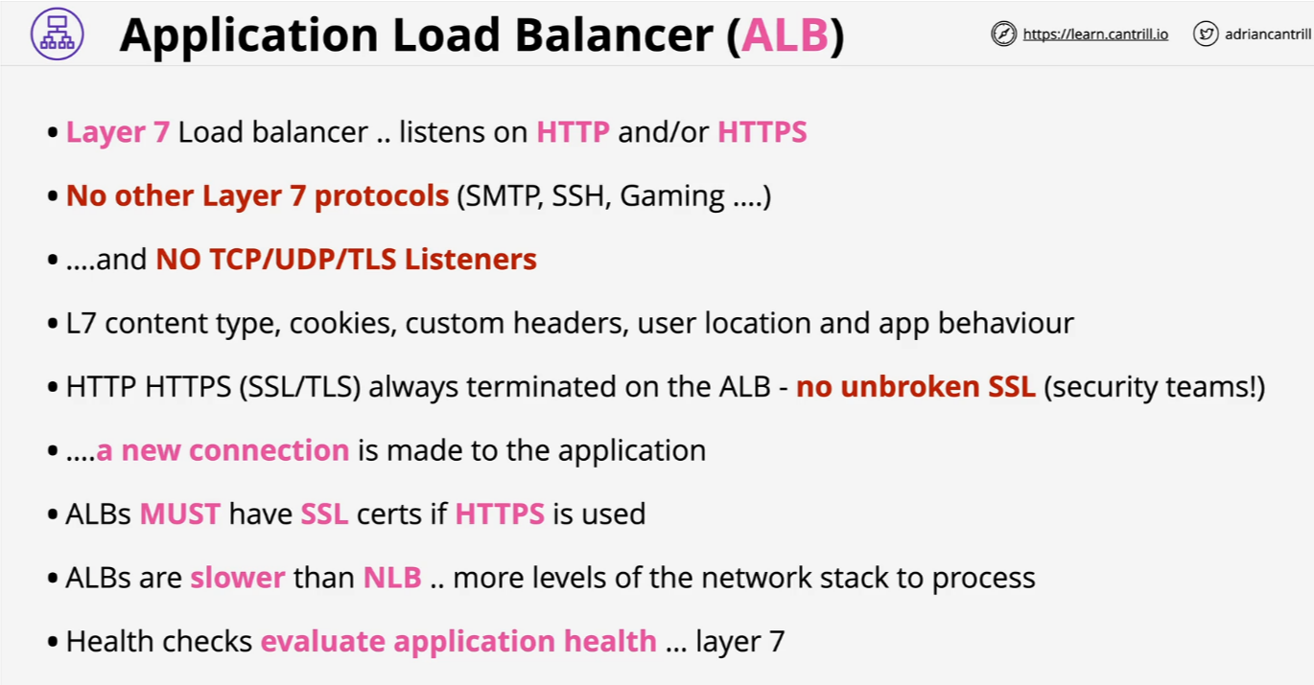
Application Load balancing (ALB)

Slide 12
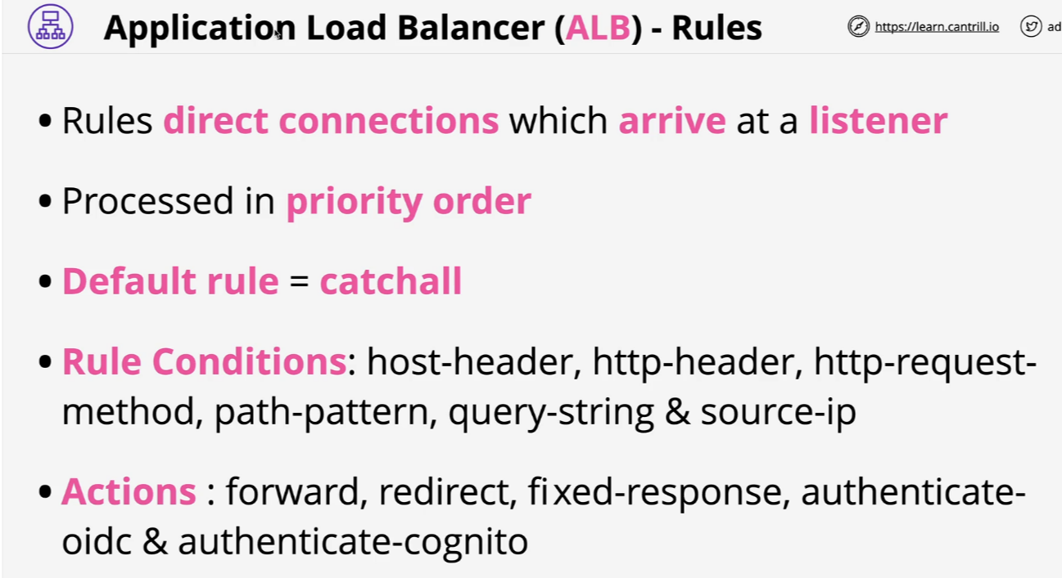
Application Load balancing (ALB)

Slide 13
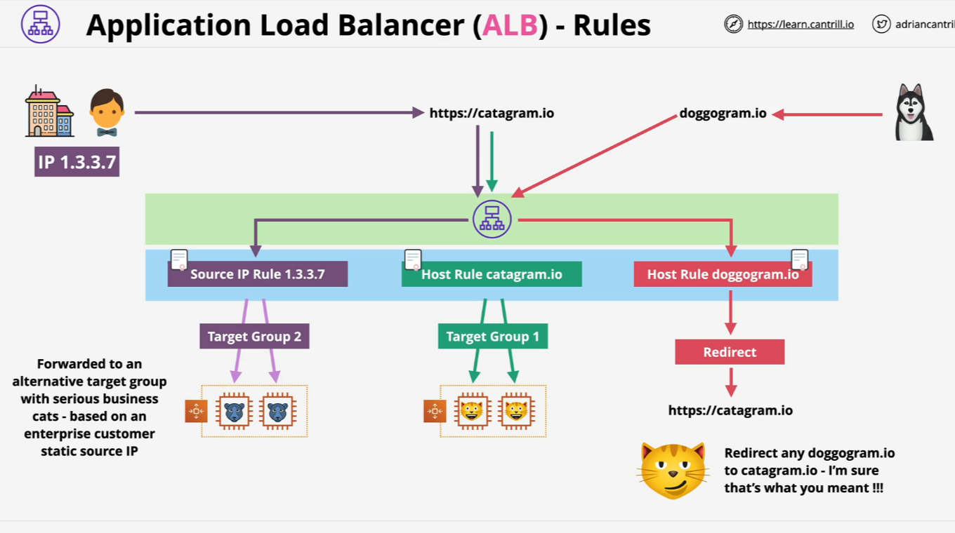
Application Load balancing (ALB)

Slide 14
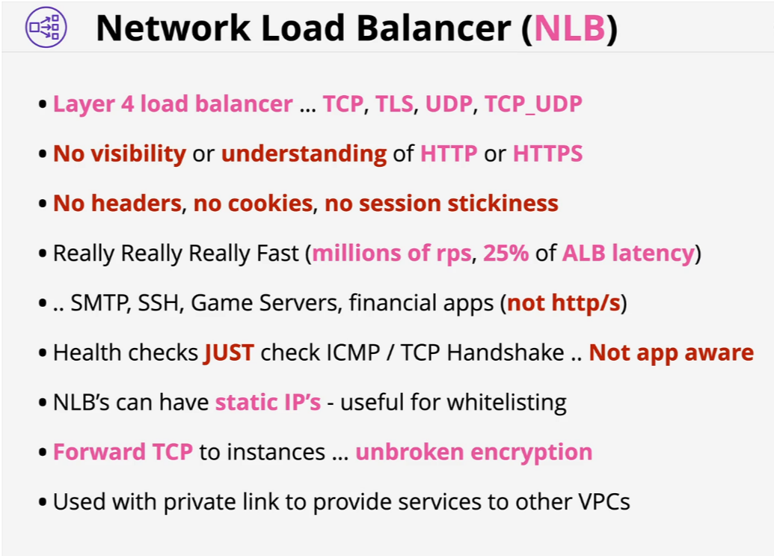
Network Load Balancing (NLB)

Slide 15
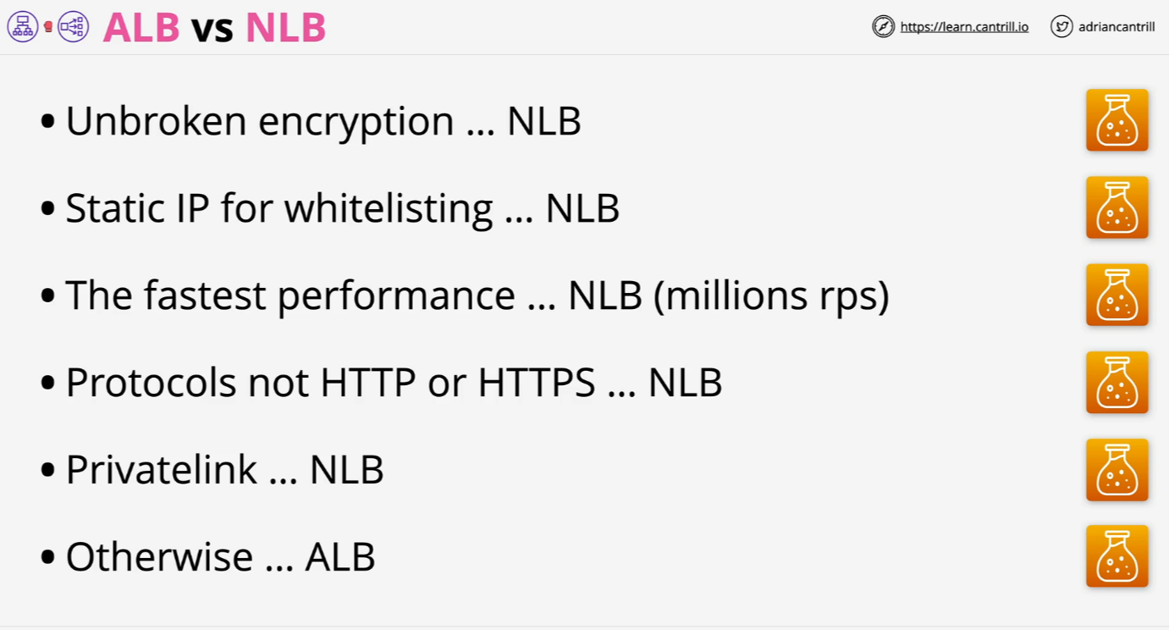
ALB vs NLB

Slide 16
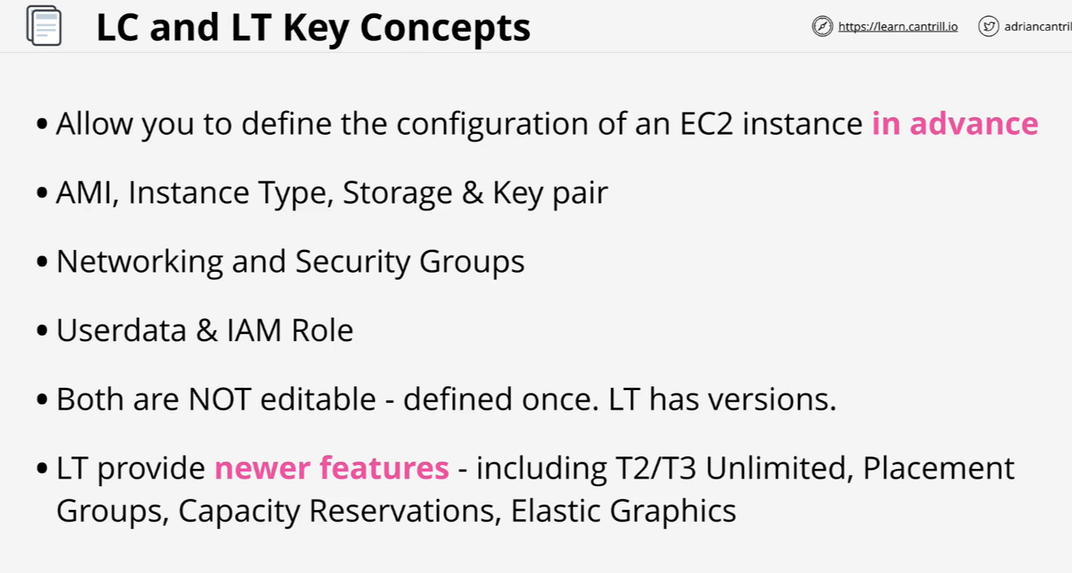
Launch Configuration and Templates

Slide 17
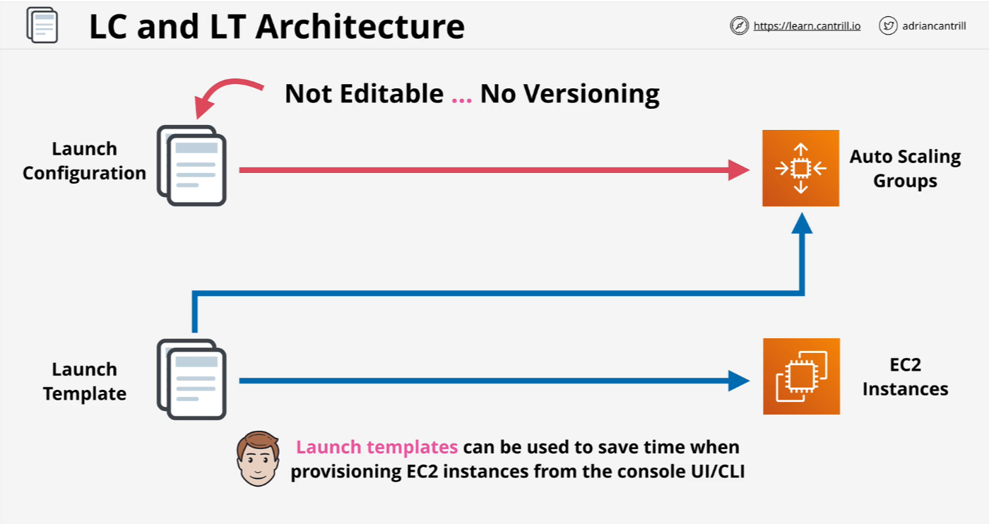
Launch Configuration and Templates

Slide 18
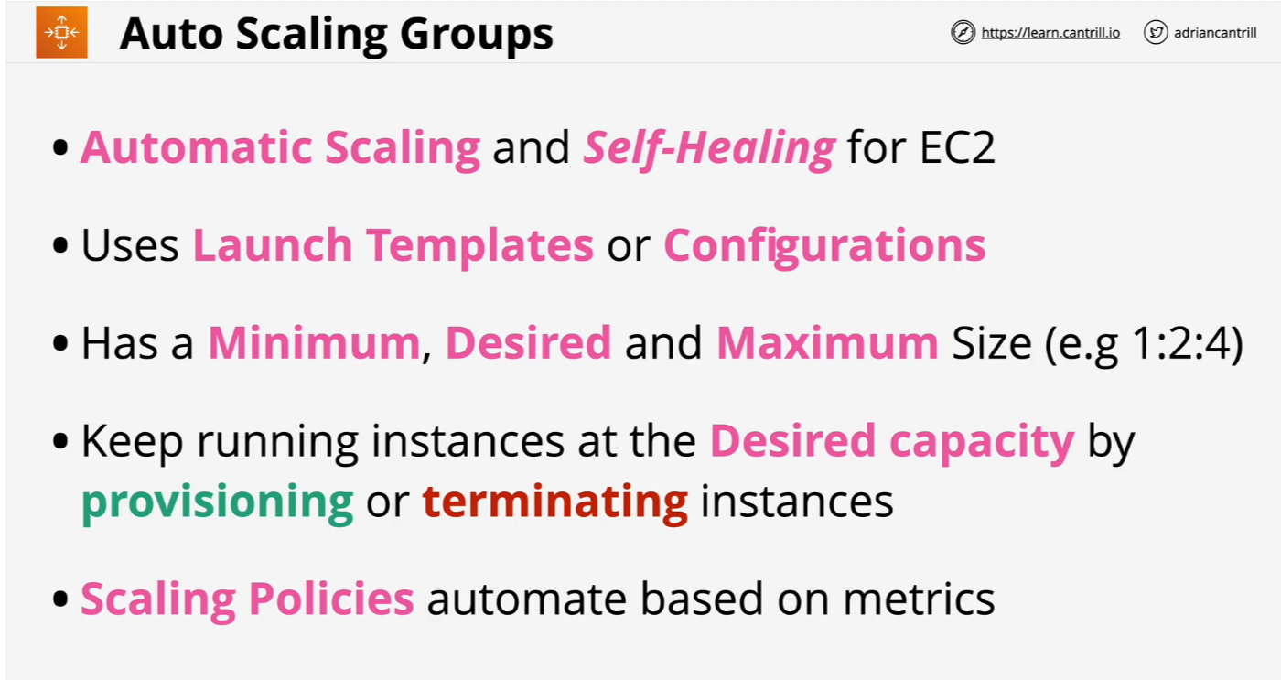
Auto-Scaling Groups

Slide 19
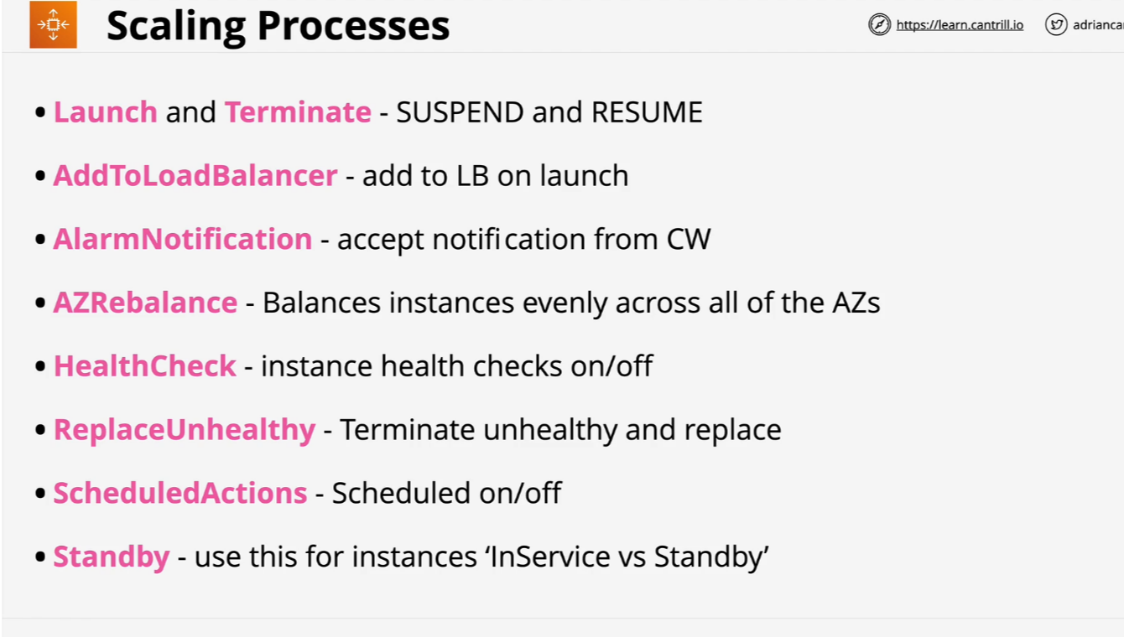
Auto-Scaling Groups

Slide 20
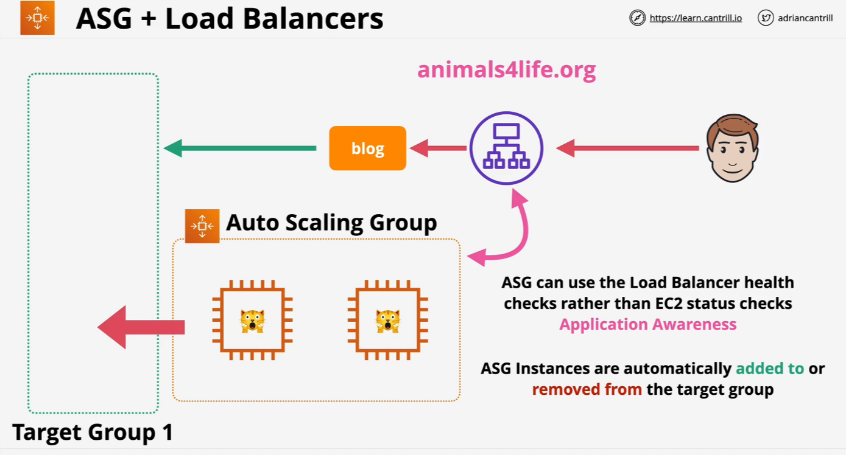
Auto-Scaling Groups

Slide 21
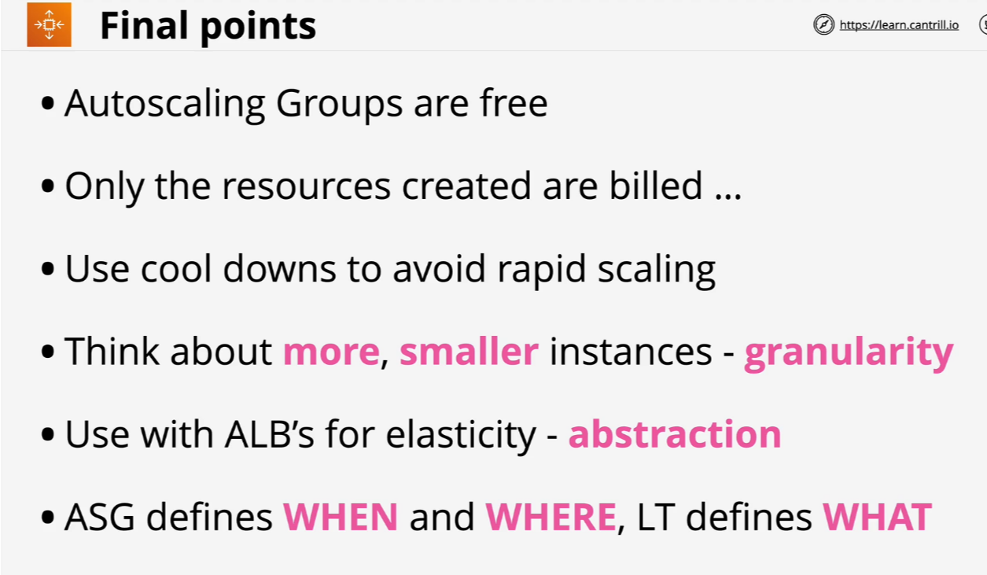
Auto-Scaling Groups

Slide 22
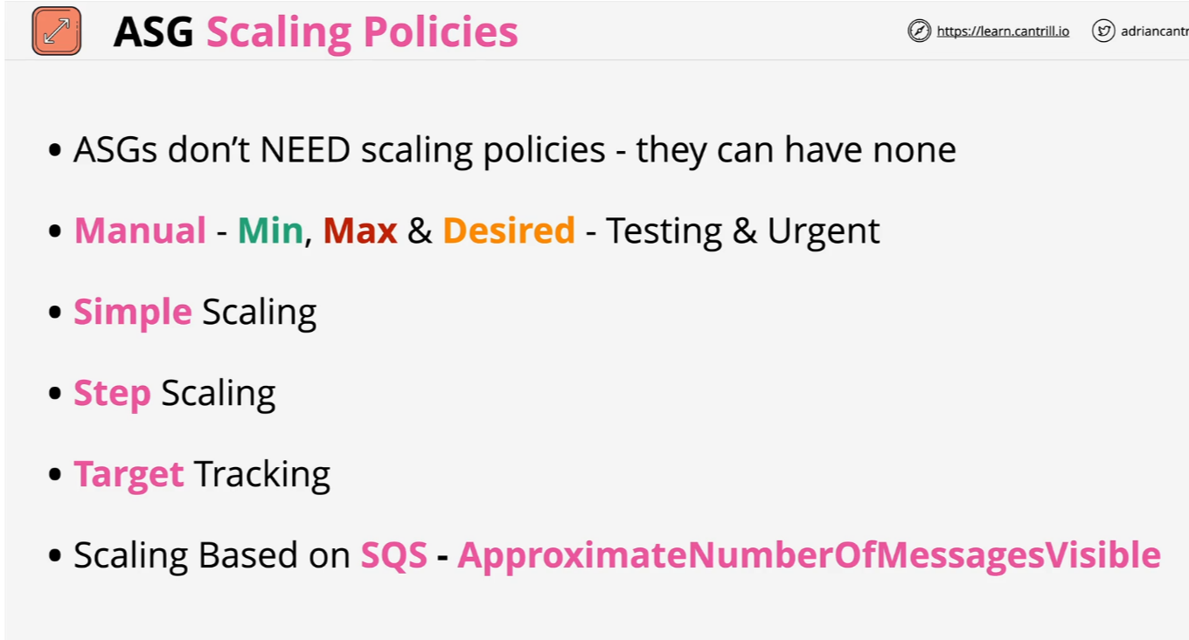
ASG Scaling Policies

Slide 23
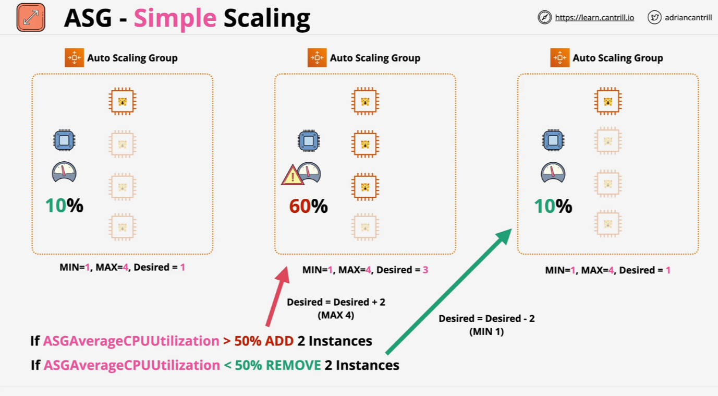
ASG Scaling Policies

Slide 24
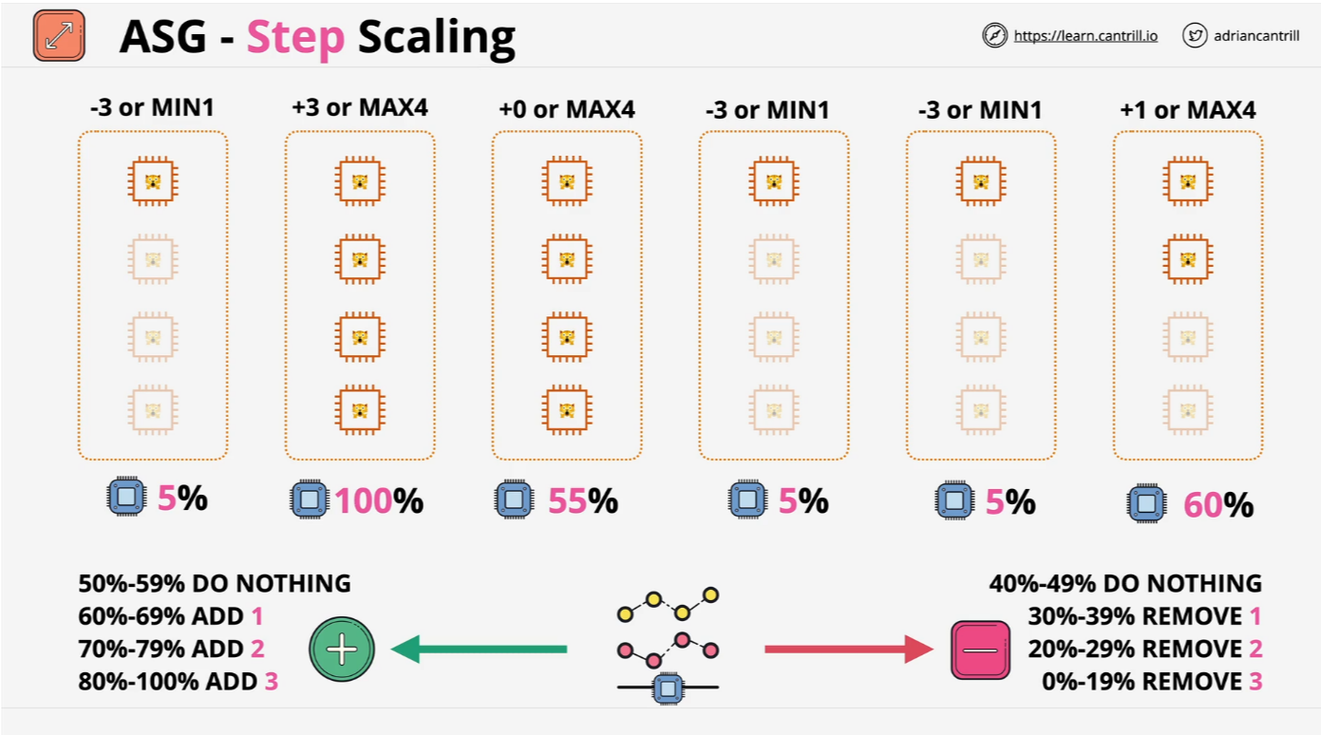
ASG Scaling Policies

Slide 25
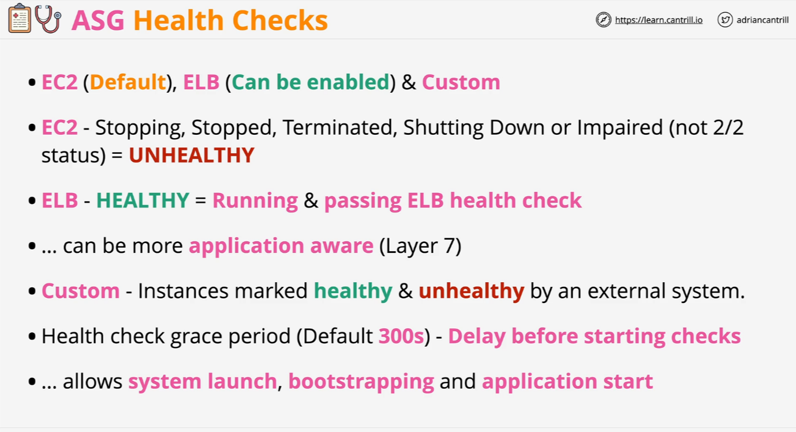
ASG Health Check

Slide 26
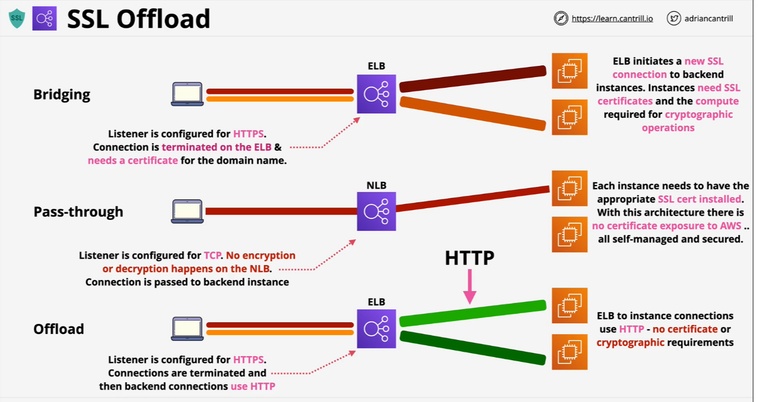
SSL Offload

Slide 27
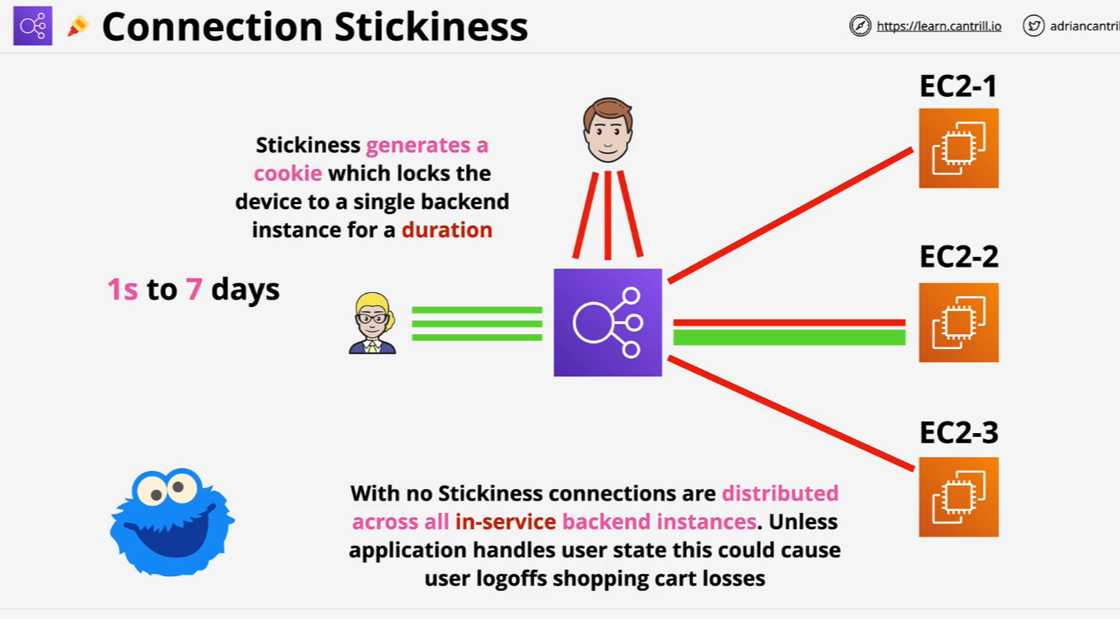
Session Stickiness

Slide 28
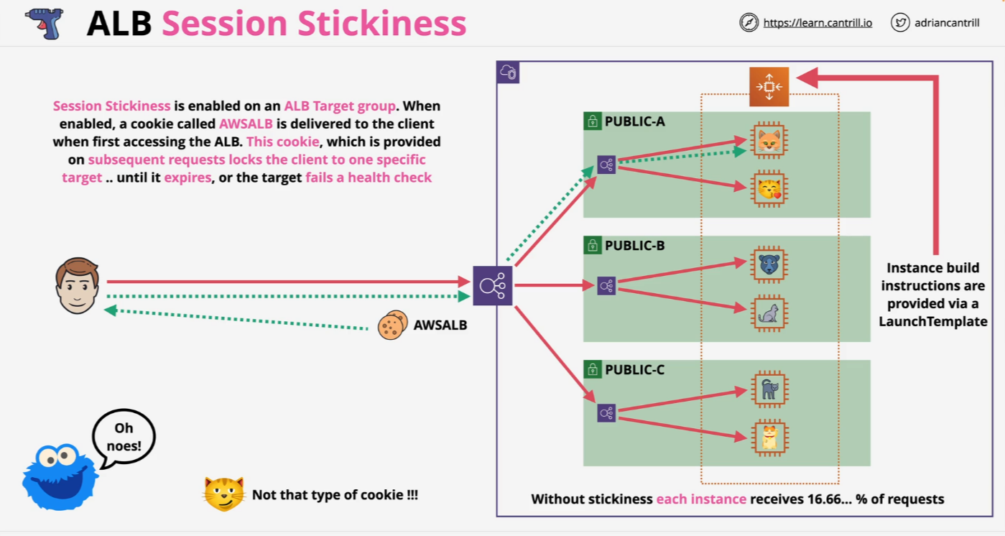
Session Stickiness

Slide 29
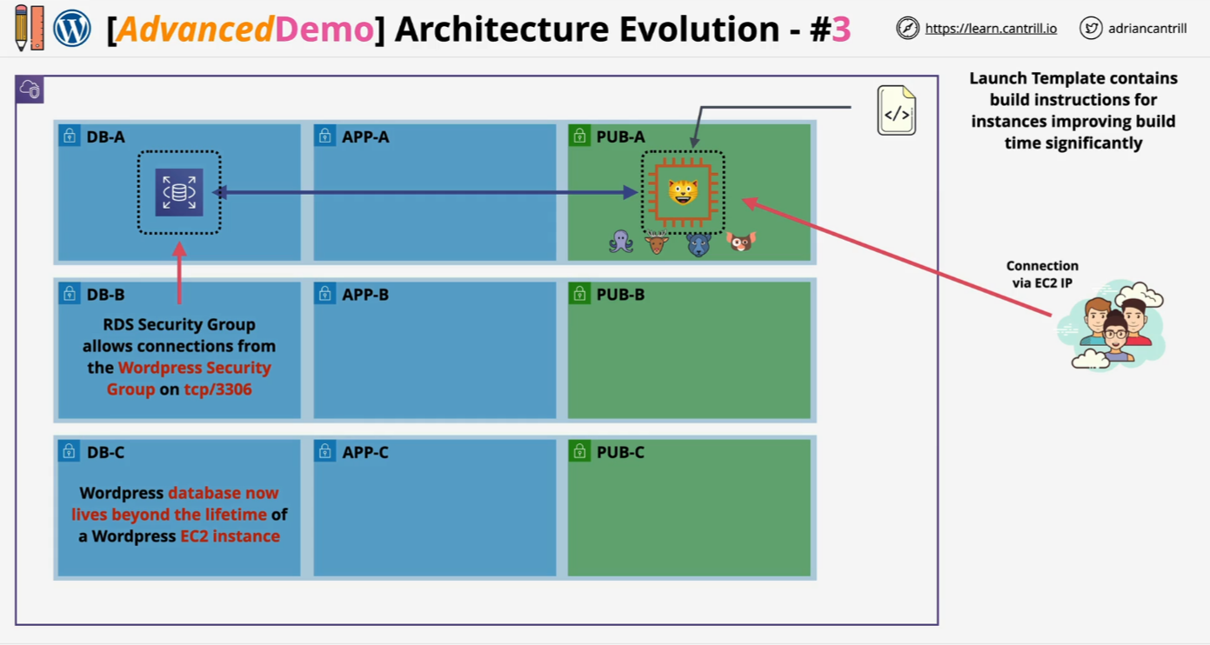
Architecture Evolution - STAGE3

Slide 30
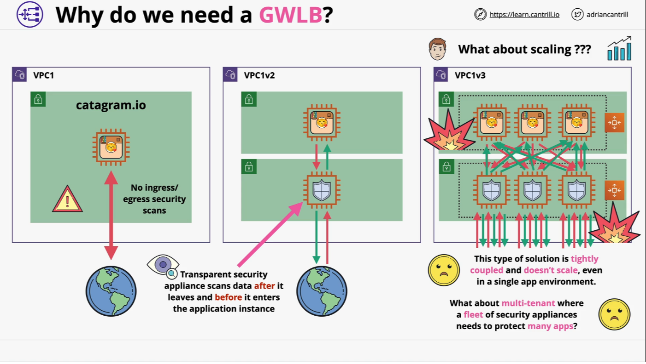
Gateway Load Balancer

Slide 31
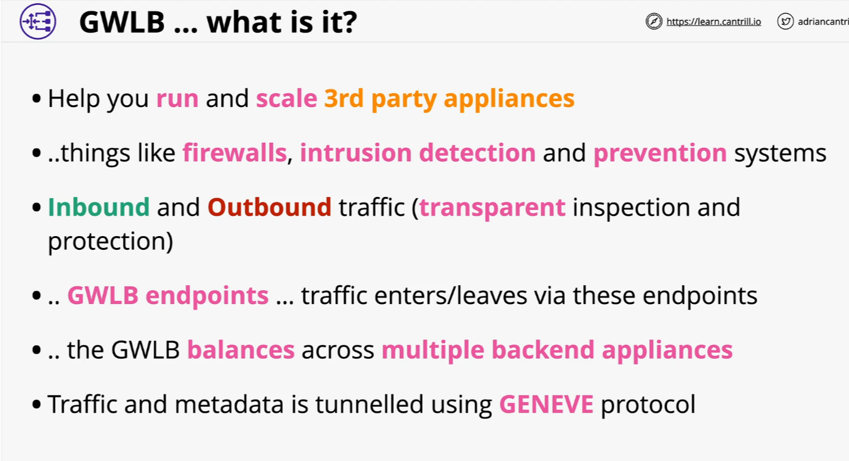
Gateway Load Balancer

Slide 32
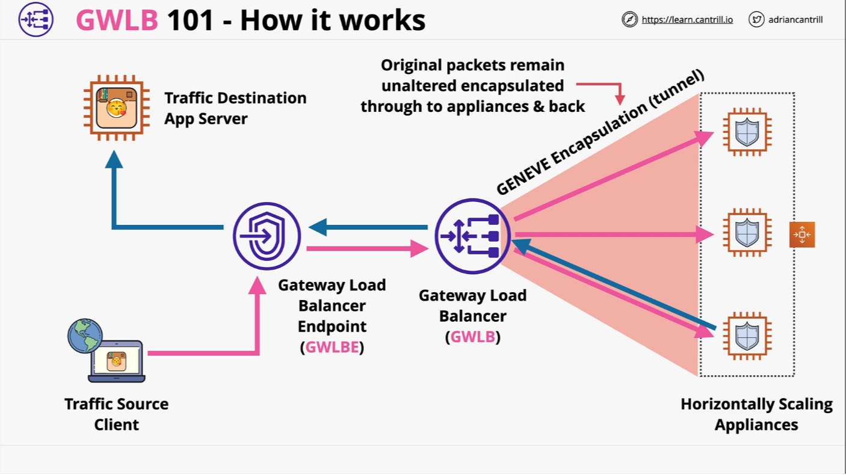
Gateway Load Balancer

Slide 33
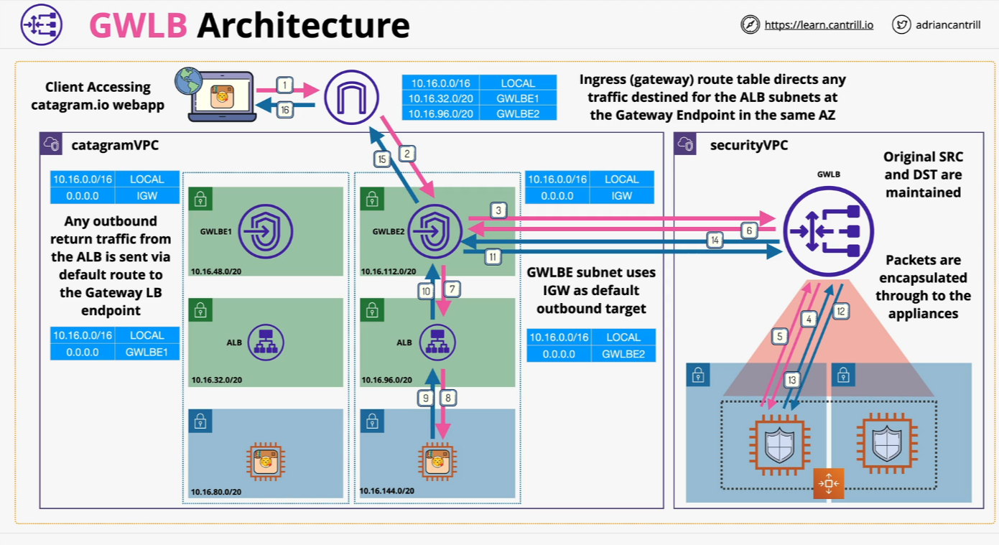
Gateway Load Balancer Architecture

